Slide 1
Field-Level Validation
18 December 2013
Notes:
Guidewire training materials contain Guidewire proprietary information that is subject to confidentiality and non-disclosure agreements. You agree to use the information in this manual solely for the purpose of training to implement Guidewire software solutions. You also agree not to disclose the information in this manual to third parties or copy this manual without prior written consent from Guidewire. Guidewire training may be given only by Guidewire employees or certified Guidewire partners under the appropriate agreement with Guidewire.

Slide 2
Lesson objectives
By the end of this lesson, you should be able to:
Implement field-level validation in the data model
Implement field-level validation in the user interface
Implement input masks to guide user input
This lesson uses the notes section for additional explanation and information. To view the notes in PowerPoint, choose View→Normal or View→Notes Page. If you choose to print the notes for the lesson, be sure to select “Print hidden slides.”

Slide 3
Lesson outline
Field-level validation in data model
Field-level validation in UI
Input mask and validation enhancements

Slide 4
Field-Level Validation
Validation is a general application behavior that prevents a user from saving invalid business data
For example, specifying a policy expiration date that is prior to the policy's effective date
Field-level validation is a validation behavior tied to one or more specific fields, which can be implemented at:
Data model level
Datatypes
Field validators
UI level
Validation expressions
Notes:
There are other types of validation beyond field-level validation. For example, business rules can execute validation behavior at a global level when the error may not relate to one specific field. For example, imagine that an insurance carrier allows up to 4 cars to be covered on a single personal auto policy. Then, imagine that on a given policy, an underwriter enters five cars. The business data is invalid, but there isn't any one field that is causing the error.

Slide 5
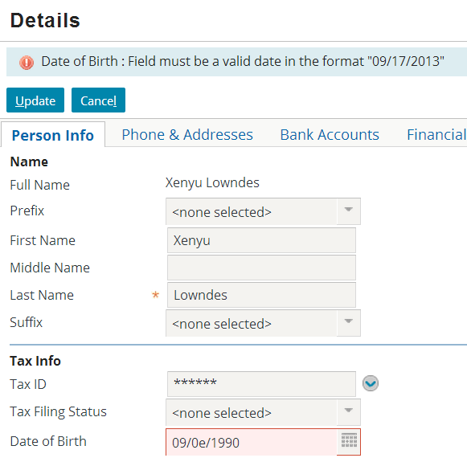
Datatypes
Guidewire inherently requires all fields to have values that are legal for the field's underlying datatype
Guidewire automatically prevents data of the wrong datatype from being saved and warns the user of the error
Notes:
In the example above, the user is attempting to save a date value with alphabetic characters. Every Guidewire application will automatically prevent the save, highlight the problematic field, and display an error message identifying what the problem is. This is inherent behavior that does not require any configuration.

Slide 6
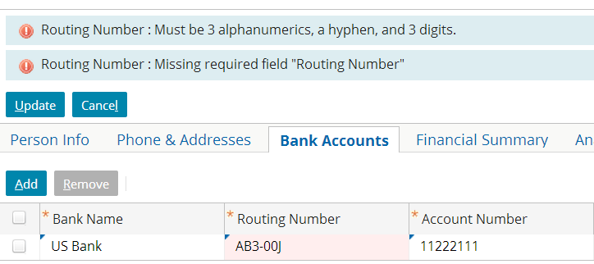
Field Validators
A field validator is a pattern that is tied to one or more fields in the data model
If field value does not match pattern, data cannot be saved and error message is displayed
Notes:
Field validators enable you to require that a particular field match a regular expression (regex). This is a deeper level of validation than that provided by data-model validation. If a field is configured as being of “varchar” type, the values “11-1111” and “AA-AAAA” would both be valid values for that field. Field validators, however, enable you to configure the application so that a value such as “11-1111” would be rejected, even though it is valid for the configured data type.
Field validators are useful when the validation logic involves simple pattern matching and the pattern holds true every time the field is used.
Field validators are configurable. The base application comes with several field validators, but these can be modified or removed, and new ones can be added.

Slide 7
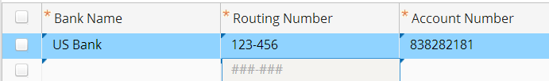
Components of a field validator
Name - Name of validator, such as "RoutingNumber"
Value - Pattern that must be matched, such as: "Three alphanumerics, a hyphen, three digits"
Description - Display message when pattern not matched, such as "Must be three alphanumerics, a hyphen..."
Input mask - Optional mask applied to any field tied to validator, such as "###-###"
Notes:
Input masks can also be added to given widgets of type text input and cell input through the widgets' inputMask property. This property takes a Gosu expression that returns a string to use as the input mask. If one is not specified, the input mask specified on the value's field validator will be used (if one is configured). This field should only be necessary in cases where the data type has no mask or where the mask needs to be conditional. The input mask returned should be of the same format as a mask specified using the input-mask attribute on a field validator (using # for wildcards). The input mask is recalculated on every render, which means that if the mask is conditional and dependent on other data on this page then it can change from one request to the next.

Slide 8
Steps to implement field validator
Create error message display key
Create field validator
Associate field validator with entity field
Deploy the changes

Slide 9
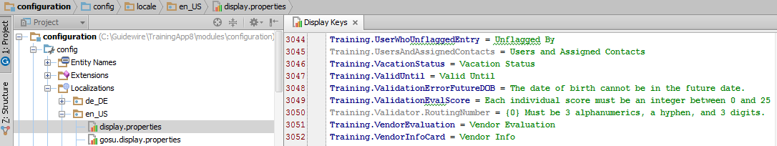
Step 1: Create error message display key
Typically, must be created from Display Keys editor, found under Localizations
Field validator error message conventions
Grouped under Validator
Begin with place-holder for widget name: {0}
Notes:
Display keys for locations or widgets are referenced in Studio under Localization. Enter the new display key specific to the application. In this example, the display key highlighted pertains to the Routing Number field validation, which is in the Guidewire Training Application.
Field validator display keys are referenced in XML files, not in Studio. Therefore, there is no way to open a dialog box in which the value of a new display key can be entered. Consequently, the display key must be created from the Display Key editor.

Slide 10
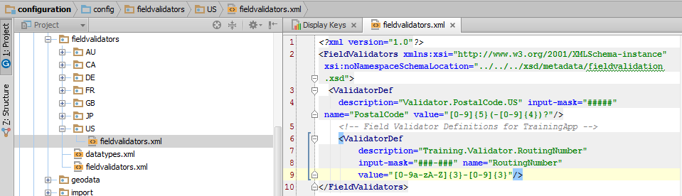
Step 2: Create field validator
Field validators declared in fieldvalidators.xml

Slide 11
Validator def: Name and description
Each validator declared in <ValidatorDef> tag
name attribute names validator
description attribute names display key
Display keys must be used (cannot be hard-coded string)
Do not include "displaykey." in value

Slide 12
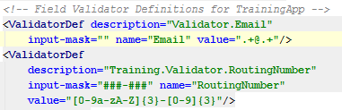
Validator def: Value
Syntax for pattern includes:
[charRange]{X} - X characters in charRange, which can be any combination of 0-9, a-z, and A-Z
[charRange]{X, Y} - From X to Y characters in charRange
.+ - Any non-empty string
\. - A period (the "\" is an escape character)
Most other characters (such as -) are treated as literals
Notes:
In the screenshot above, the pattern for the RoutingNumber validator is:
Any 3 alphanumeric characters, specified as: [0-9a-zA-Z]{3}
A hyphen, specified as: -
Any three digits, specified as: [0-9]{3}
In the screenshot above, the pattern for the Email validator is:
Any non-empty string, specified as: .+
An "at" symbol, specified as: @
Any non-empty string, specified as: .+
A period, specified as: \.
Any non-empty string, specified as: .+
Characters that are not treated as literals and must be escaped include: [ ] ( ) { } . * + ?
For a complete listing of syntax for validator patterns, consult the Configuration Guide for your product.

Slide 13
Validator def: Input Mask
Syntax for input masks:
# - Any characters the user can type
Rendered in UI as a "."
All other characters (such as -) are treated as literals
To specify no input mask, use ""
Notes:
If a mask has fixed characters on the end, the application displays those characters outside of the text field. For example ####mph appears as a field #### with mph on the outside end of it.
More details on input masks appear later in this lesson.
For a complete listing of syntax for input masks, consult the Configuration Guide for your product.

Slide 14
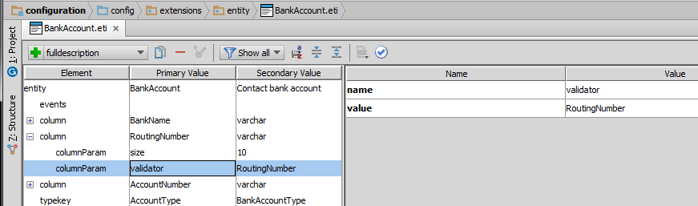
Step 3: Associate validator with entity field (1)
For custom fields (fields not declared in base app), add the field using the Entity editor

Slide 15
Step 3: Associate validator with entity field (2)
Associate the validator with the entity field in the entity file using the Entity editor

Slide 16
Step 4: Deploy changes
New and modified field validators are data model changes
To deploy data model changes, restart application server
Field validators are not listed in Data Dictionary
Notes:
Because field validators are not listed in the Data Dictionary, there is no need to regenerate the Data Dictionary when you are making only field validator changes.

Slide 17
Lesson outline
Field-level validation in data model
Field-level validation in UI
Input mask and validation enhancements

Slide 18
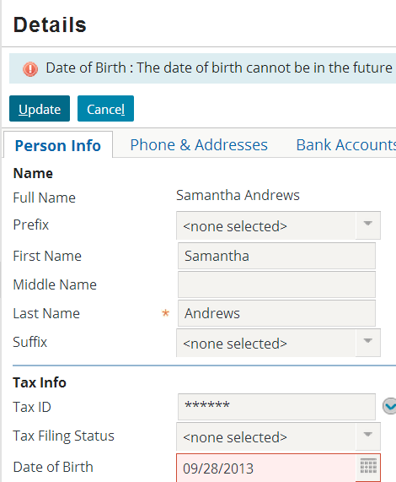
Field-level validation in the user interface
Implemented by logic tied to given atomic widget
Useful when:
You want the same field to be treated differently in different parts of application, or
Logic is simple enough that it makes sense to store it at UI level
Notes:
Field-level validation is typically tied to the two widget types used most often to enter data: inputs and cells.
Validation error messages are displayed at the top of the screen in the same way that other errors, such as required fields with missing values, are shown.
Field-level validation checks data only when it is entered through that specific PCF file. It does not check data entered in other ways, such as through other PCF files, through Gosu code (such as business rules and enhancement methods), or through import processes.

Slide 19

Validation expression
A validation expression is an expression associated with a single atomic widget that implements field-level validation
If expression returns NULL, save is allowed
If expression returns string (an error message), then save is prevented, field is flagged, and message is displayed at top of screen
Example:
save prevented
(anABContact as ABPerson).DateOfBirth > gw.api.util.DateUtil.currentDate()
? displaykey.Training.ValidationErrorFutureDOB
: null
save allowed
Notes:
Validation expressions are typically written using a ternary expression that returns either NULL or a string (typically stored as a display key).
If NULL is returned, the data is considered valid and the save is allowed.
If errorMessage is returned:
The widget is flagged.
The string (the error message) is displayed.
The save is prevented.
Any Gosu expression that returns either NULL or a string (such as a call to a method) can be used.

Slide 20
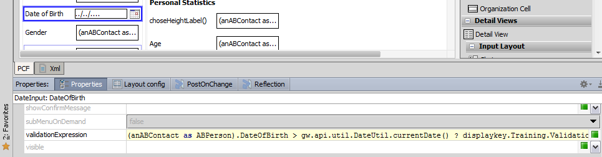
The validationExpression attribute
Syntax: condition ? NULL : errorMessage, or condition ? errorMessage : NULL
Typically written using ternary operator
NULL and error message can come in either order
Notes:
Recall that a ternary expression consists of a condition and two values. If the condition is true, the expression after the ? and before the : is returned. If the condition is false, the expression after the : is returned.
Inputs and cells have two attributes that can be used for validation expressions: validationExpression and requestValidationExpression. Request validation expressions are executed during any call to the server, whether it is to commit data or to simply move to another part of the current location (such as from one card to another). This means that the condition can be evaluated before the user attempts to commit the data. However, the condition does not have access to the current value of any widget. It can check only the last saved value of widgets beyond the given widget.
Commit validation expressions are executed when the application attempts to commit the widget's value. This means that the condition is evaluated immediately before the data is saved. However, because all widget values are being saved at this point in time, the condition can check the value of other widgets as well.
The vast majority of the time that you want to implement a validation expression, it should be using the validationExpression attribute. This is considered to be the more user-friendly approach as it doesn't evaluate the data until the user is done with his or her work. requestValidationExpression is designed for the small number of cases where an invalid data value might produce extraordinary results, such as a thrown exception, before the user even commits the data. For example, a card view might have a field for a date on one card that is used to display information on some other card, and a bad date on one card will make the second card unrenderable.

Slide 21
Field-level validation in data model
Field-level validation in UI
Input mask and validation enhancements

Slide 22

Input mask provides a watermark
Does NOT restrict user input!
Appears as a watermark in field
Information only; not part of the data input
Disappears when user enters data in field
Tooltip when user mouse-overs field
Notes:
An input mask does not restrict the user input for the field. Rather than an input mask restricting user input, client-side regular expressions (client JavaScript and Regex) notify the user of an issue with the field input.
An input mask identifies to the user the specific form of the data to enter into a given field.
Typically, an input mask is a basic pattern applied to a field. In Emerald Guidewire applications, input mask behavior differs from Diamond Guidewire applications: when the field is empty, an input mask appears in the field, but as a watermark; a mouse over tooltip shows the input mask; and when the focus is on the field and the user begins to type, the watermark disappears.
It is also possible to localize the input mask by defining the input mask in the entity field validator file (fieldvalidators.xml) for the given locale or, if supported by the input widget, specify a display key for the inputMask property.

Slide 23
Input mask configuration
Entity field validator:
User interface (UI) widget:
Define a validator column parameter for the entity
In fieldvalidators.xml, create a <ValidatorDef />
Specify an input-mask attribute value
Localize the input mask with locale specific fieldvalidators.xml
Preferred practice for
Uniformity and maintainability
inputMask property
Text Input
Cell Input
Specify an inputMask value
String literal or display key
Gosu expression
Use a Gosu expression for conditional input mask
Evaluated on page (re)render
Extensibility a concern
Notes:
Configurators often define input masks with entity field validators in the fieldvalidators.xml file. In the fieldvalidators.xml file, configurators specify the value of the input-mask attribute within a <ValidatorDef /> element. An advantage of this approach is that you can localize the fieldvalidators.xml file per locale.
Text input and cell input widgets also support an inputMask property. This property takes a string expression. You can use a Gosu expression that returns a string as the input mask. This is typically how configurators specify a conditional input mask. However, an input mask of this type necessitates that the server evaluate the Gosu expression on every page (re)render. For a localized input mask, consider using a display key.

Slide 24
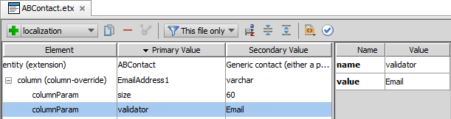
Entity field validation
Specify a columnParam validator for the given field
Specify a value for input-mask attribute in the validator definition
<ValidatorDef description="Validator.Email" name="Email" validation-type="regex" value=".+@.+" input-mask="name@domain" />
Notes:
Entity field validation requires that you define a validator column parameter in the entity or entity extension. In addition, you must create a validator definition element in the fieldvalidators.xml file that matches the column parameter name. An advantage of this approach is that you can re-use validator definitions for various entities.
In the slide, the focus is on the input-mask attribute and defined value.

Slide 25
Widget inputMask property
Specify an expression for the inputMask property
String literal
Display key
Gosu expression for conditional input masks
Applicable to only Text Input and Cell Input widgets
Email address example:
<TextInput editable="true" id="EmailAddress2" … inputMask="&quot;othername@domain&quot;" …/>
In field watermark and mouse over help text
Notes:
For certain input widgets, you can specify an expression for an inputMask property. An expression can be a string literal, a display key, or a Gosu expression. A display key has an advantage of being easily localized. Gosu expressions require a page (re)render but in doing so expose the potential for creating conditional input masks.
It should be noted that placeholders (#) are not a requirement for an inputMask property expression.

Slide 26


Implicit regex validation from input mask
If a placeholder (#) defines an input mask, client-side regular expression (regex) validation is inferred
Restricts data input to mask format
Triggers regex validation
Tax ID example:
<TextInput editable="true" id="TaxID" … inputMask="&quot;###-##-####&quot;" …/>
Notes:
When a field specifies an input mask that contains placeholders (e.g., #) but does not specify either a regex property and does not have an associated entity field validator, the framework generates an implicit regular expression based on the inputMask property definition.
As user types in the field, the implicit regex triggers client-side validation.

Slide 27


Regex validation
Client-side validation using JavaScript and regular expression (regex)
As the user types, the application validates input
Invalid field value triggers a red box warning
Mouse over the field to see the validation error message

Slide 28
Regex validation configuration
Entity field validator
User interface (UI) widget
Define a validator column parameter for the entity
In fieldvalidators.xml, create a <ValidatorDef />
Specify the value attribute with a regular expression (regex)
Localize the regex in a local fieldvalidators.xml file
Set the regex property for
Text Input
Cell Input
Specify a regex value
String literal
Gosu expression
Use a Gosu expression for conditional regex
Evaluated on page (re)render
Notes:
You can configure regex validation on an regex property of supported input widget or in the entity field validator definition.
Configurators often define validation expression with entity field validators in the fieldvalidators.xml file. In the fieldvalidators.xml file, configurators specify the value of the value attribute within a <ValidatorDef /> element. An advantage of this approach is that you can localize the fieldvalidators.xml file per locale.
Text input and cell input widgets also support a regex property. This property takes a string expression. You can use a Gosu expression that returns a string as the regular expression. This is typically how configurators specify a conditional expression for field validation. The application evaluates the Gosu expression n every page (re)render.

Slide 29
Entity field validation and regex
Specify a columnParam validator for the given field
Specify a regex expression for the value attribute
If regex, validation-type attribute is optional
<ValidatorDef description="Validator.Email" name="Email" validation-type="regex" value=".+@.+" input-mask="name@domain" />
Notes:
Entity field validation requires that you define a validator column parameter in the entity or entity extension. In addition, you must create a validator definition element in the fieldvalidators.xml file that matches the column parameter name. An advantage of this approach is that you can re-use validator definitions for various entities.
In this slide, the focus is on the validation-type and value attributes.

Slide 30
UI widget explicit regex validation
Define for the regex property a regular expression
Triggers field validation
Consider Gosu expression for conditional regex
Applicable to only Text Input and Cell Input widgets
Tax ID example
<TextInput editable="true" id="TaxID" … regex="&quot;[0-9]{3}-[0-9]{2}-[0-9]{4}&quot;" …/>
Notes:
The regular expression is in the same format as that of the validator definition. This configuration also support client-side validation. If you use a Gosu expression to return conditional regular expressions, the expression evaluates when the page is (re)rendered.

Slide 31
New practices
Avoid server-side processing for complex user input validation
Gosu validation requires server-round trip including conditional regex
Consider rule based validation
Depending on widget type, use
Entity field validation
UI widget properties
Specify a regular expression validation
Specify a descriptive input mask without placeholders
If a regex is not defined, a placeholder input mask automatically generates an implicit regular expression

Slide 32
Lesson objectives review
You should now be able to:
Implement field-level validation in the data model
Implement field-level validation in the user interface
Implement input masks to guide user input

Slide 33
Review questions
What are the two types of field-level validation at the data model level? Can both of them be configured?
Assume that there is an Order entity that has an OrderNumber field. The field appears on two detail views: LegacyOrdersDV and NewOrdersDV.
Name a situation where you would implement validation logic for the OrderNumber field at the data model level.
Name a situation where you would implement validation logic for the OrderNumber field at the UI level.
What happens if a widget's validation expression returns null?
Notes:
Answers
1. Datatype validation (which cannot be configured) and field validators (which can be configured).
2. a) Possible answer: The OrderNumber field has a pattern, such as two characters, a hyphen, and five characters, and this pattern must be followed everywhere the field is used.
b) Possible answer: On the detail view for orders imported from a legacy system, the order number could take any format. On the detail view for orders created in the Guidewire application, the order number must start with the characters "GW-“.
3. The save is allowed—a return value of null signifies that the validation condition was met.

